Slide 1


Criminal Justice Challenge Brief
Fall 2024 MIT Policy Hackathon
Leveraging Data Science to Augment Judicial Decision-Making in Resentencing for High-Stakes and High-Risk Cases

Slide 2




redo.io
Company
A technology startup building data science tools for criminal justice reform in California, US.
Technology Partners
Supported By
LexLab @ UC Law SF 2024 Justice Tech Accelerator

Slide 3

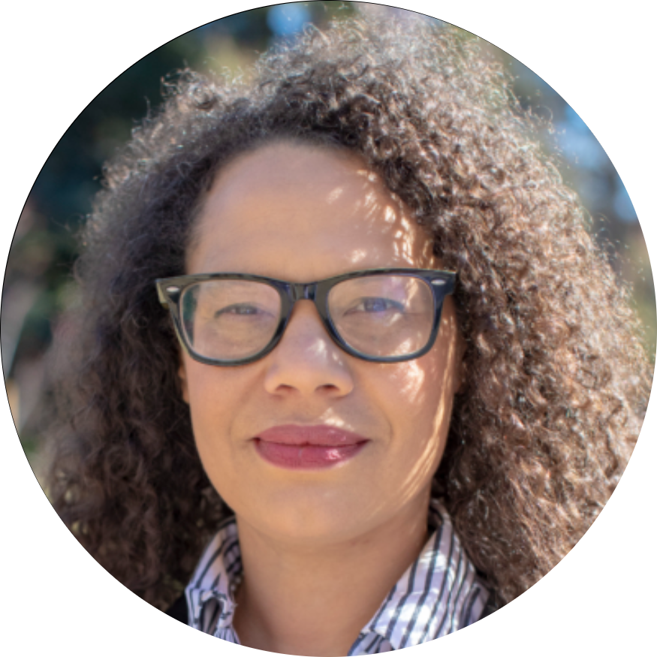
Represented By
Aparna Komarla — Founder, Lead Data Scientist
Aparna founded Redo.io in 2023 to build data science solutions that improve outcomes in the criminal legal system. Her journey in justice reform began in 2017 as an educator in a youth detention facility near Sacramento, CA followed by San Quentin State Prison.
Susan Champion — Advisor
Susan Champion is the Deputy Director at Stanford Law School’s Three Strikes Project. For the past several years, she has been working with the Project on sentencing reform issues and played an integral role in the development, drafting, planning and implementation of the Three Strikes Reform Act of 2012 (“Proposition 36”), as well as the implementation of Proposition 47.

Slide 4

Problem
In 1997, Mr. Heyberger was sentenced to 65 years-to-life under California's "Three Strikes" law for residential burglary.
More than two decades of hard work and rehabilitation later, Peter returned home to his family under the 2018 resentencing law. Today, Peter is dedicated to his work as an electrician and maintenance worker
Source: For the People
500+ individuals
25+ Years
$10M USD/year
Harshly sentenced non-violent, non-serious offenders
Sentence length
Taxpayer costs
Note: Statistics are for CA Department of Corrections (CDCR)

Slide 5



Background
Legal Provisions
Reform
1. Prop 36 (2012)
Reduce or eliminate sentences for non-serious, non-violent felonies.
2. Prosecutor Initiated Resentencing (2018)
Gives prosecutors the discretion to reevaluate past cases and recommend lower sentences.
3. Prop 47 (2014)
Changed certain low-level crimes from potential felonies to misdemeanors.
4. Racial Justice Act (2020)
Prohibits the State from pursuing convictions or sentences based upon race, ethnicity, or national origin
PIR Pilot - Progressive DAs participate
Measure passed
Many CA counties do not have PIR
Roadblocks
Discretionary measures
Politics
Incentives
Resource constraints

Slide 6
The Redo.io Solution
Pillar I
Pillar II
Pillar III
Open databases
Analysis
Eligibility for resentencing
Create de-identified datasets on prison sentences
Review sentences and reform measures in depth for missed opportunities
Rules based models
Simple filters to find sentences of interest
GenAI tools
LLM assistant to query or search prison sentences
District attorneys, public defenders, academic researchers, journalists, reform advocates

Slide 7



Traction
Government
Academic
Public
2,000+ cases reviewed
95,000+ records released
150+ cases identified
Contract with Los Angeles District Attorney’s Office and the Three Strikes Project @ Stanford Law
Analytics to identify unjust and unfair sentences
Open searchable database on prison sentences

Slide 8
Challenge Question
Use data science to help identify and study individuals who have been harshly sentenced for low-level offenses.
Who is incarcerated in our prisons and for what reasons?
Who is eligible for “second-look” case reviews through reform laws?
Does the data show any bias that should be taken in consideration when supporting the eligibility determination for AB2942?
Dashboard Visuals
Exploratory Analysis
GenAI tools
Decision Trees
Similarity scores or metrics

Slide 9
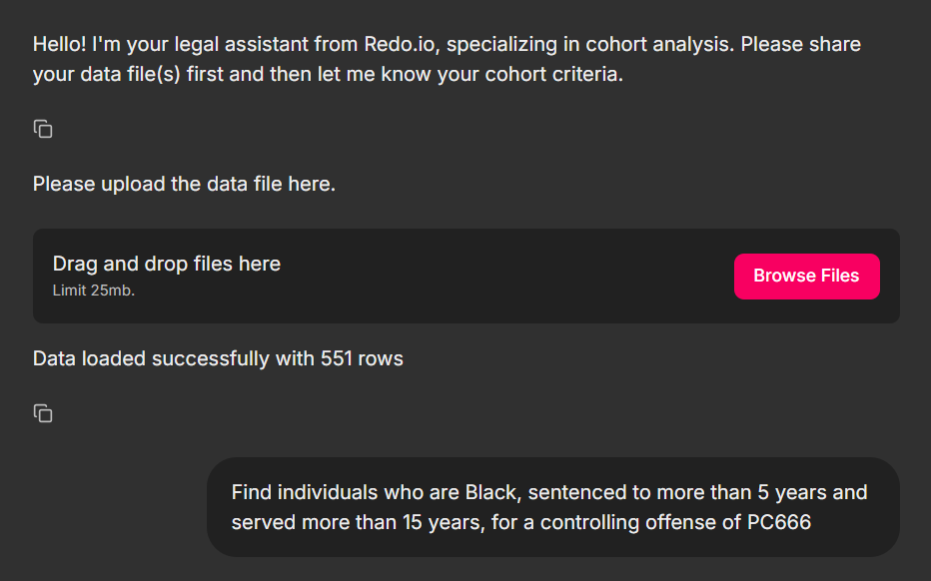
Potential Contribution
Augment judgement by courts and attorneys for high stakes + high risk decisions
1. Load the dataset
2. Pass query using natural language

Slide 10
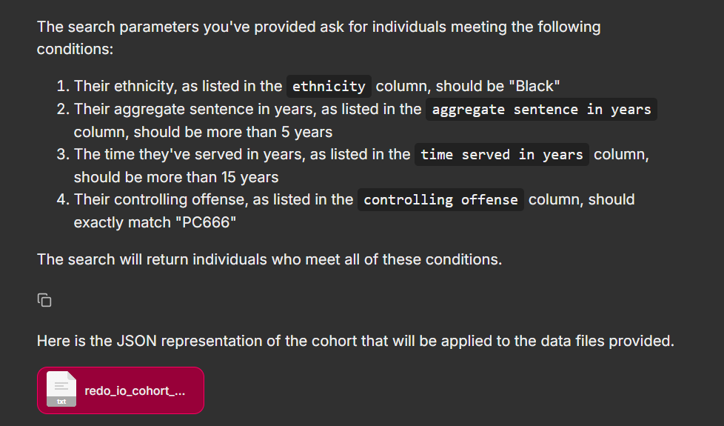
Potential Contribution
3. Description of the query, mapping to input data columns
4. Return results

Slide 11
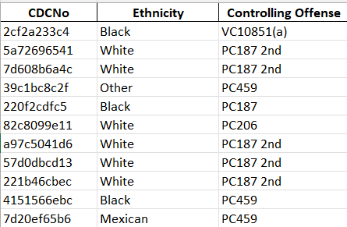


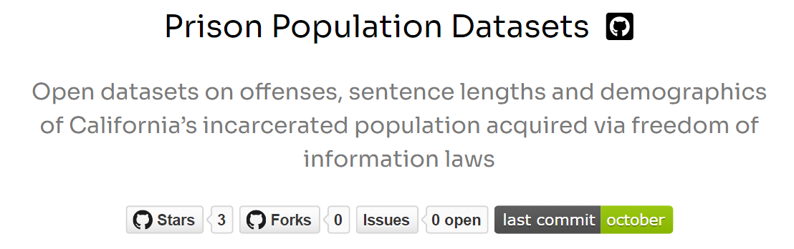

Datasets
GitHub
Roughly 95,000 individual records obtained via public records requests to the state
3 tables joined with CDCR IDs, 75 variables in total
De-identified using md5 hash algorithm
(CDCR ID + protected seed value) = unique md5 hash

Slide 12
Resources
Redo.io:
Website: www.redoio.info
Open databases on prison population sentences: https://data.world/redoio/ca-prison-sentences (data.world), https://github.com/redoio/offenses_data (GitHub)
LexLab startup accelerator: https://lexlab.uclawsf.edu/2024-09-13
Policy Measures:
Prop 36: Proposition 36: Three Strikes Law. Sentencing for Repeat Felony Offenders. Initiative Statute.
Prop 47: https://www.courts.ca.gov/documents/Prop47FAQs.pdf
Prosecutor Initiated Resentencing: Resentencing Policy FAQs | Los Angeles County District Attorney's Office

